Slide 1


Slide 2
Analysis can be used to select Indian restaurant
People travel around the world to most populous city of United states New York.
Analysis can be used by number of users. Like
tourist visiting to New York city
people living in New York
new people shifted to in and around the city
bloggers who are interested to write their blog about food or
restaurants
Food channels

Slide 3
Data Acquisition
New York City data that contains list Boroughs, Neighborhoods along with their latitude and longitude.
https://cocl.us/new_york_dataset
Indian restaurants in each neighborhood of New York
city.
FourSquare API
GeoSpace Data
https://data.cityofnewyork.us/City-Government/Borough-Boundaries/tqmj-j8zm

Slide 4
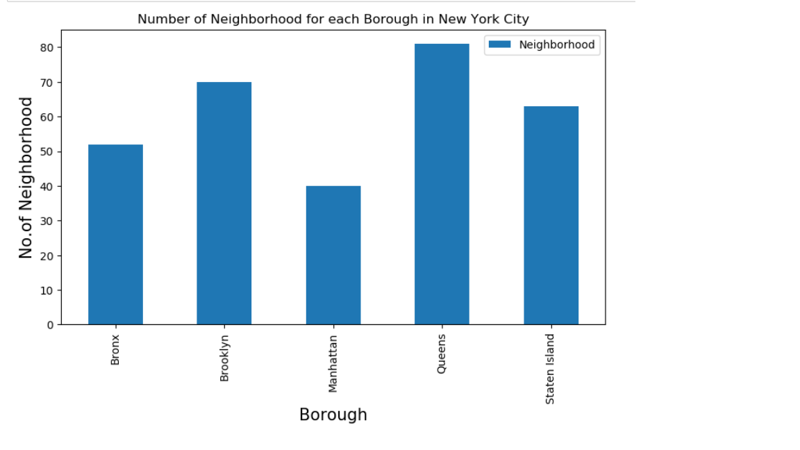
Methodology
Number of neighborhood for each borough in New York city.

Slide 5
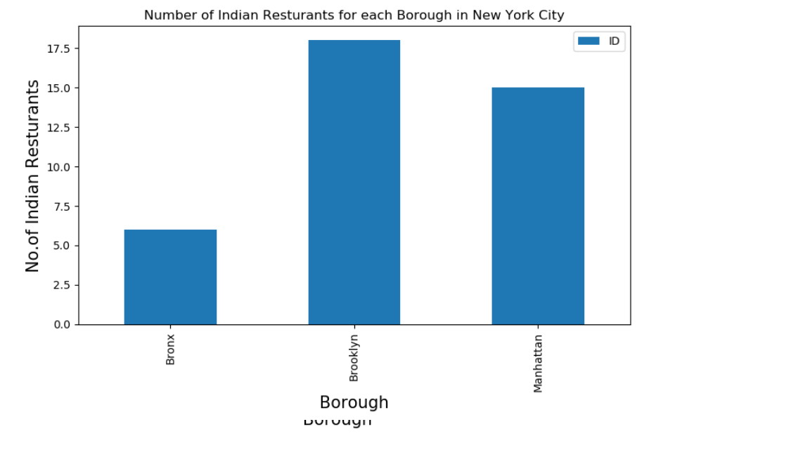
Methodology(contd..)
Number of Indian Restaurant for each borough in New York City

Slide 6
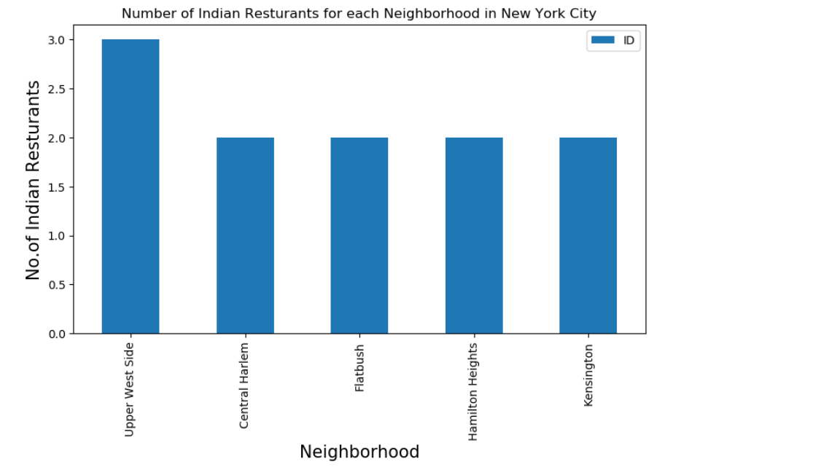
Methodology(contd..)
Number of Indian Restaurant for each neighborhood in New York City
Notes:
We can see that 'Upper West Side' has maximum Indian Restaurants

Slide 7
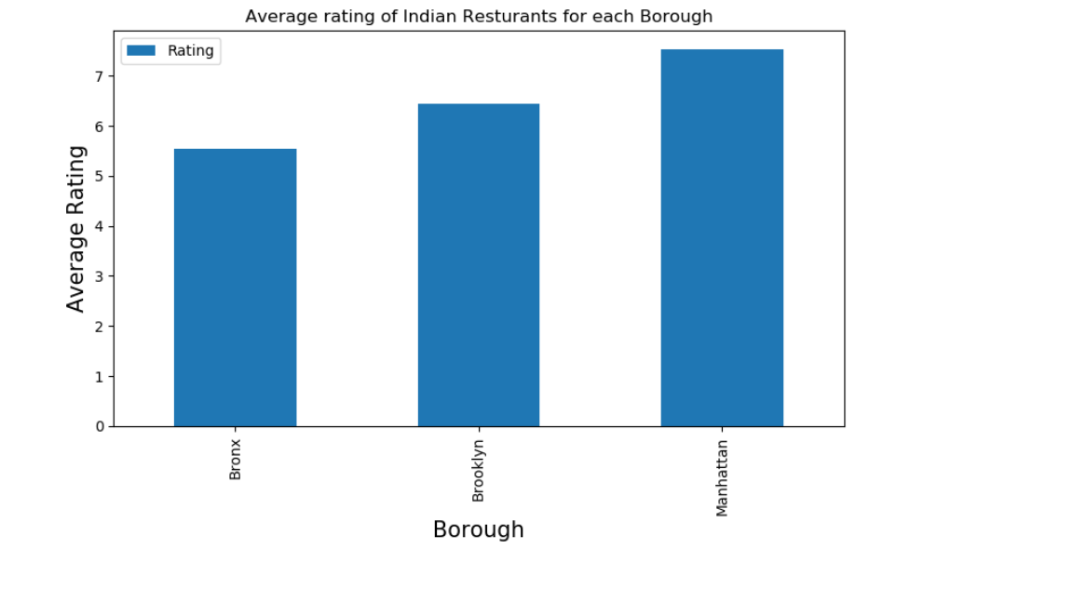
Methodology(contd..)
Average rating of Indian restaurant for each borough

Slide 8
Conclusion
Brooklyn has the largest number of Indian Restaurants.
The Upper west side in Brooklyn has the highest number of restaurants i.e. 3.
Bay Ridge (Brooklyn), Central Harlem (Manhattan), Clinton Hill (Brooklyn) are some of the best neighborhoods for Indian cuisine.
Manhattan and Brooklyn are the best places to stay if you prefer Indian Cuisine. Though Manhattan ranks first and Brooklyn ranks second in ranking ; the difference in their average rating is minimal i.e. Manhattan is with 7.83 and Brooklyn is with 7.82.

Slide 9
Thank You
Geetu Bhadauria

